Slide 1

The Aga Khan Hospital Dar es Salaam
Dr. Ali Akbar Zehri - OPA Documentation Compliance for Q4 2022

Slide 2
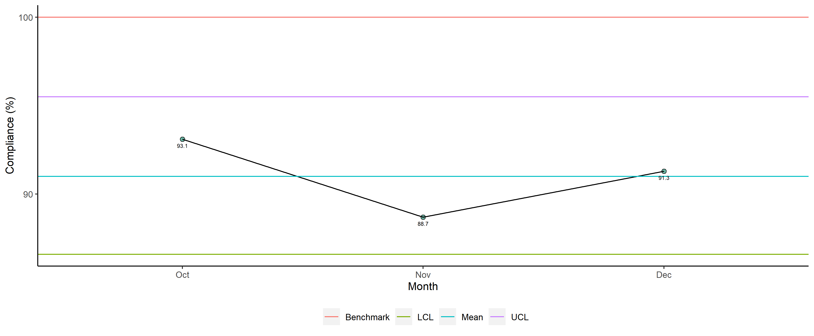
Dr. Ali Akbar Zehri - Availability of Required Documents

Slide 3
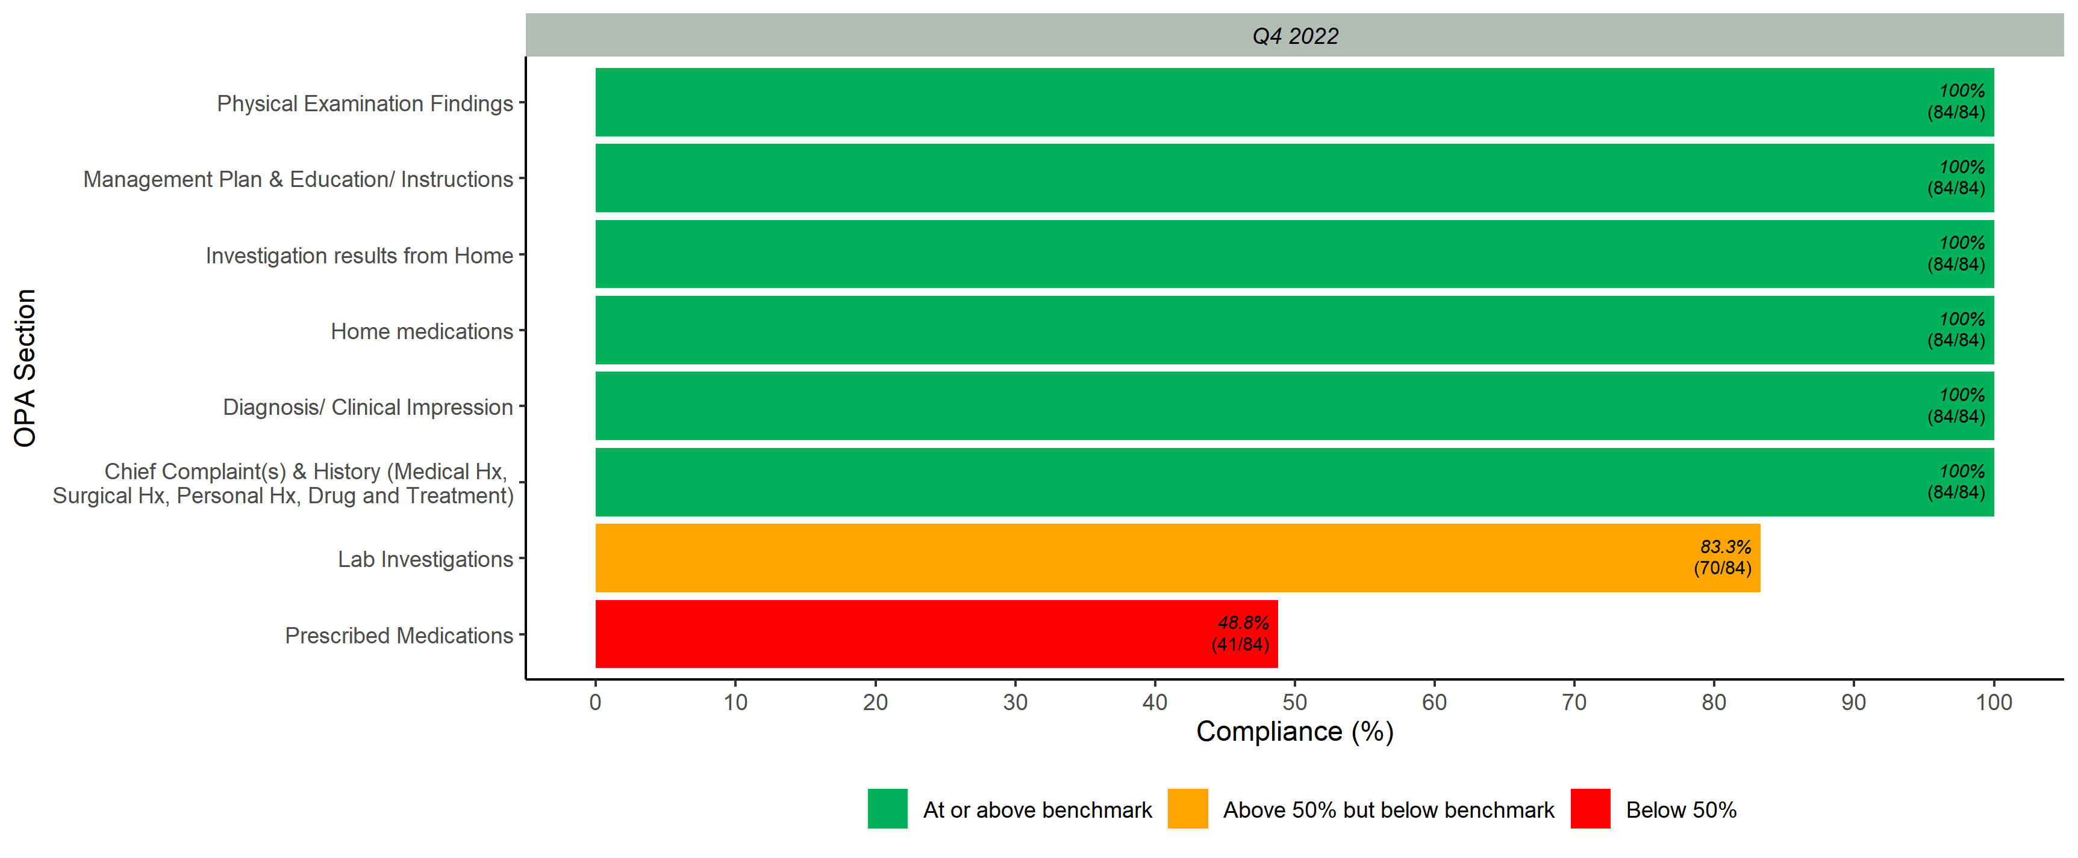
Documented Scores per OPA Section

Slide 4
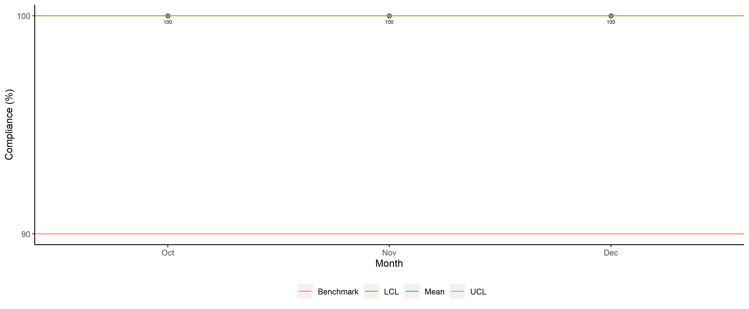
Dr. Ali Akbar Zehri - Legibility

Slide 5
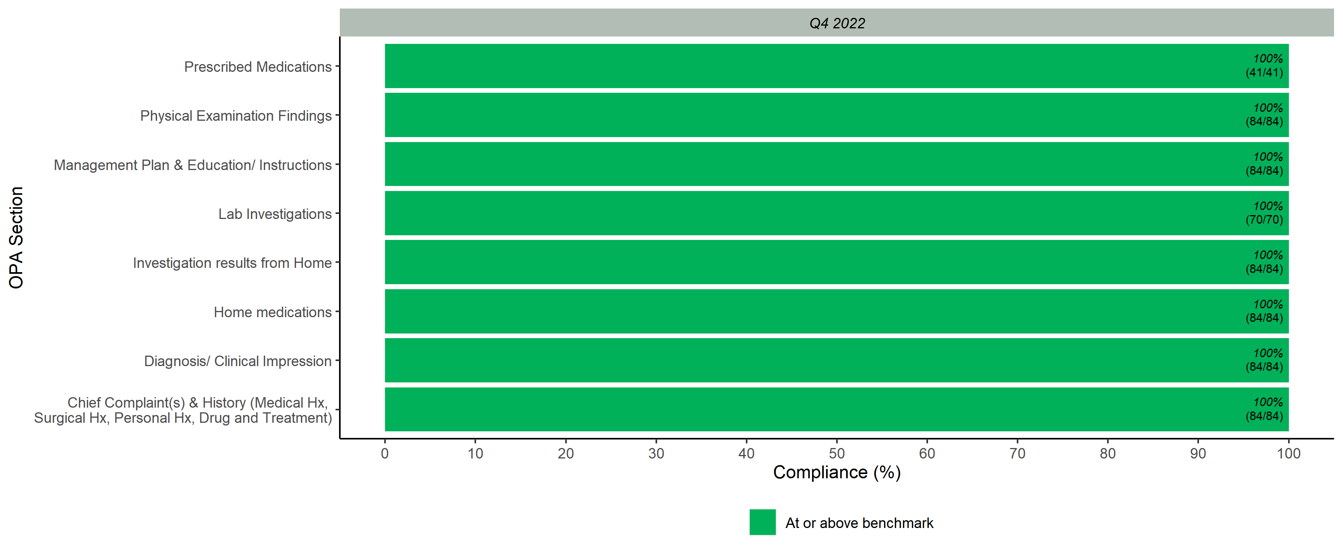
Legibility Scores per OPA Section

Slide 6
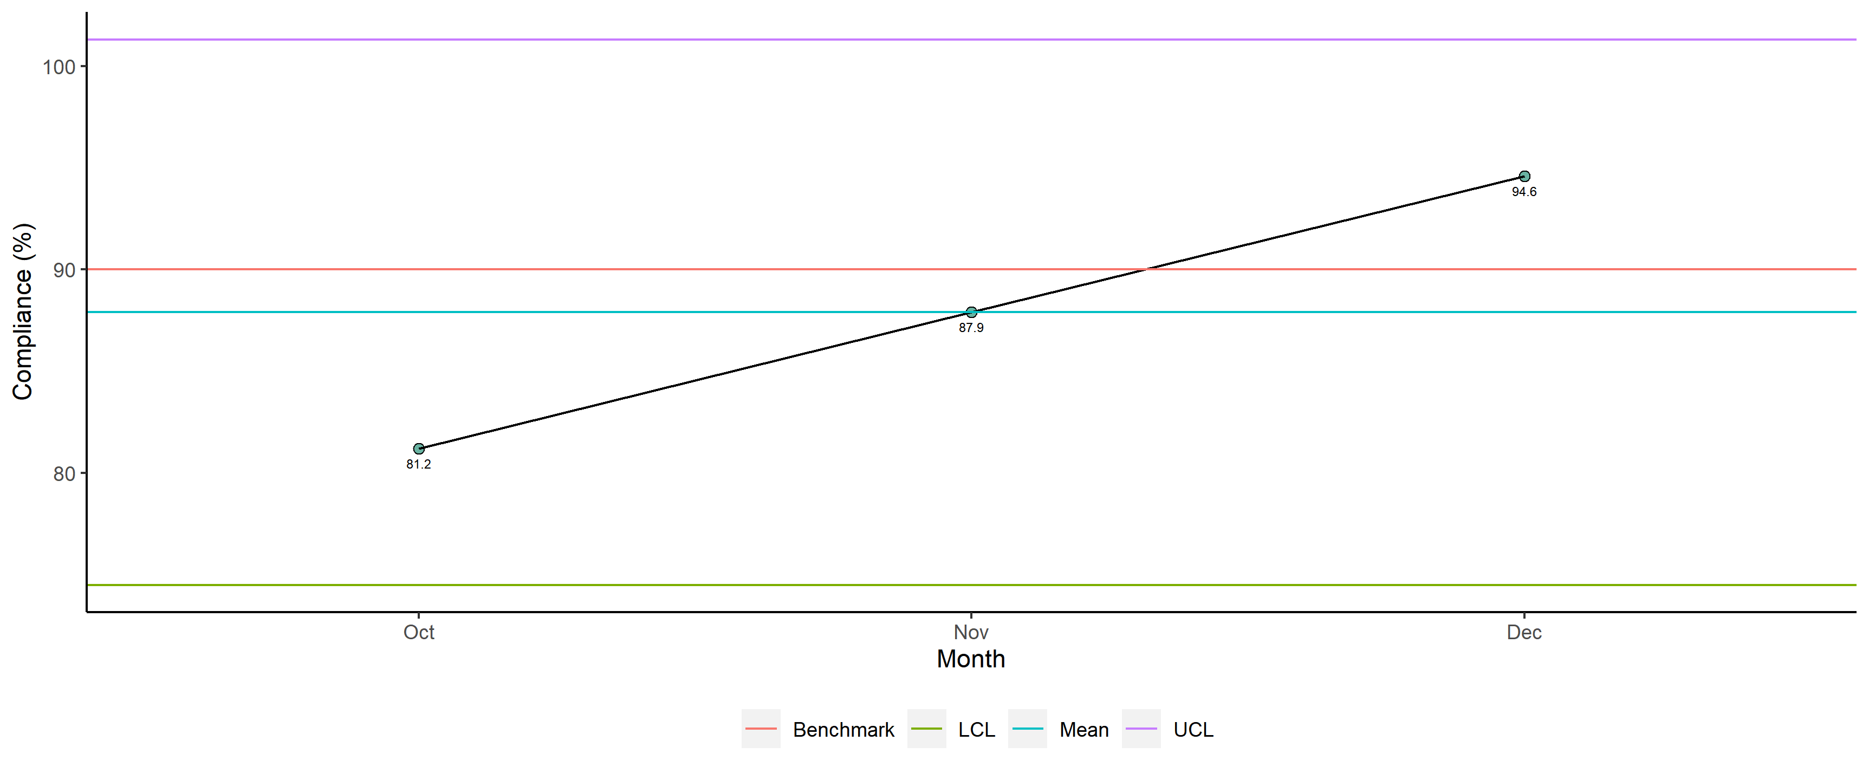
Dr. Ali Akbar Zehri - Completeness

Slide 7
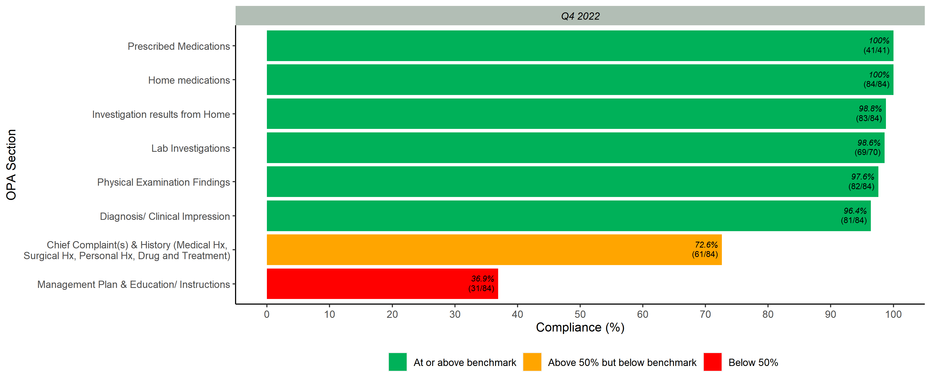
Completeness Scores per OPA Section

Slide 8
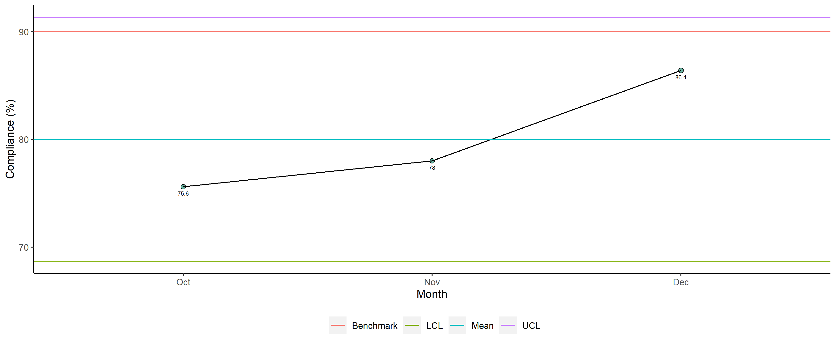
Dr. Ali Akbar Zehri - Overall

Slide 9
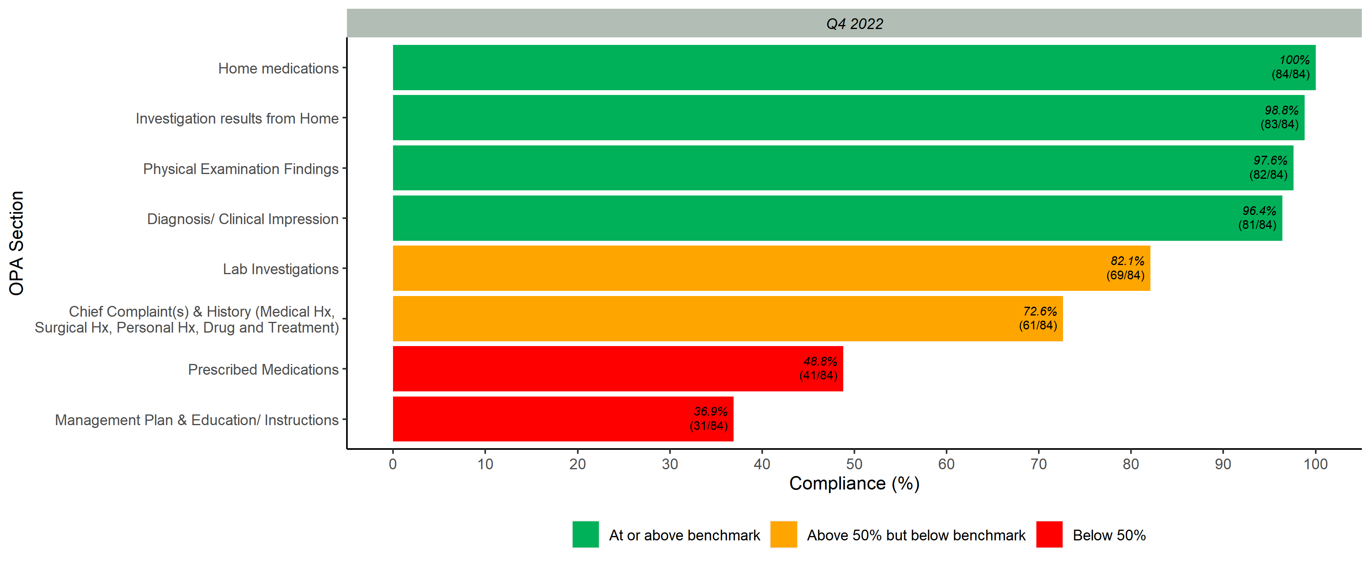
Overall Scores per OPA Section

